Slide 1
MAKING
CHANGES
Sustaining Innovative Services During a Pandemic
Lori Chapin
Sarah Nagle
Miami University Libraries

Slide 2
What We’ll Cover Today
Examples of online maker services
Maker Kits
Justifying new/ongoing costs of emerging tech to leadership

Slide 3
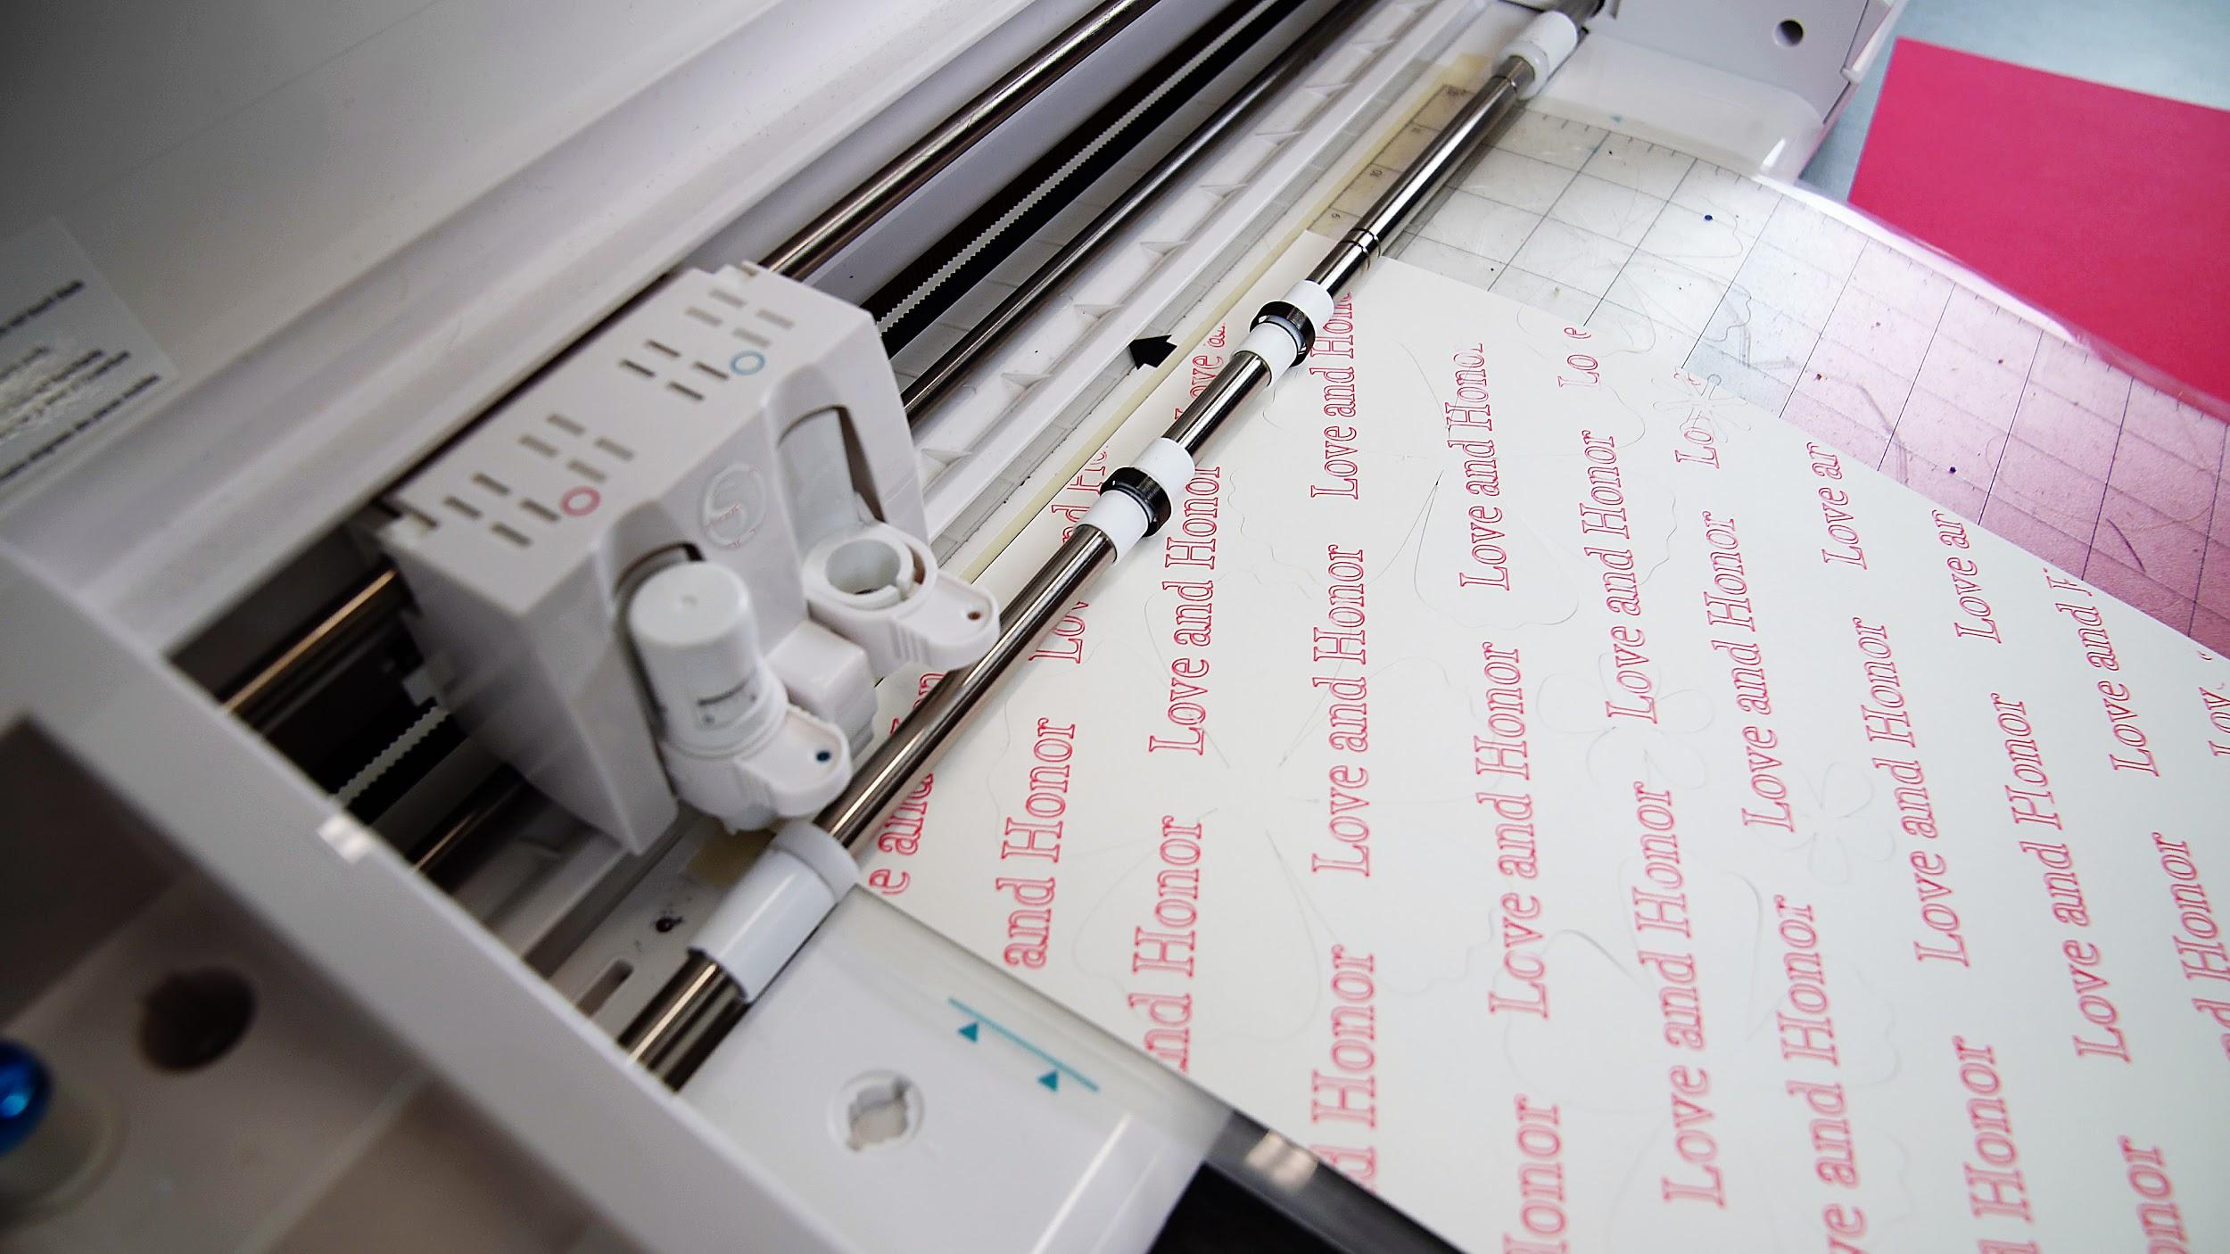
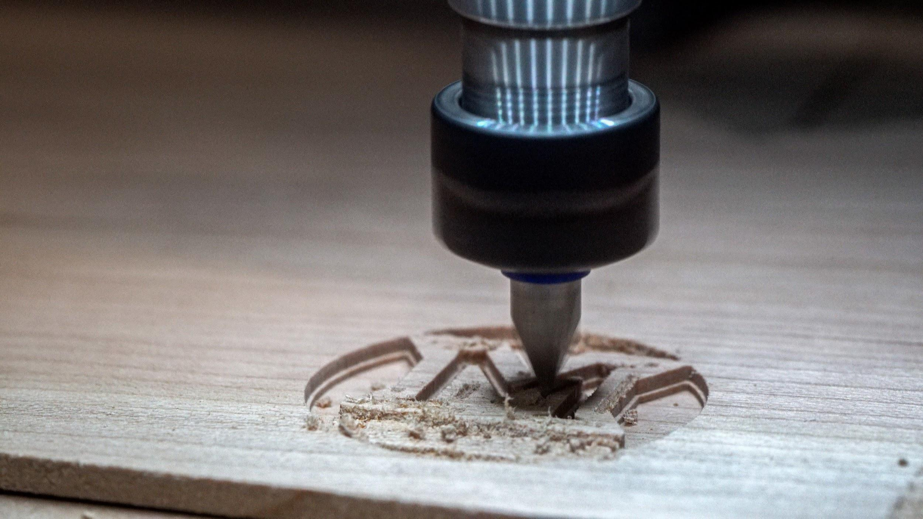
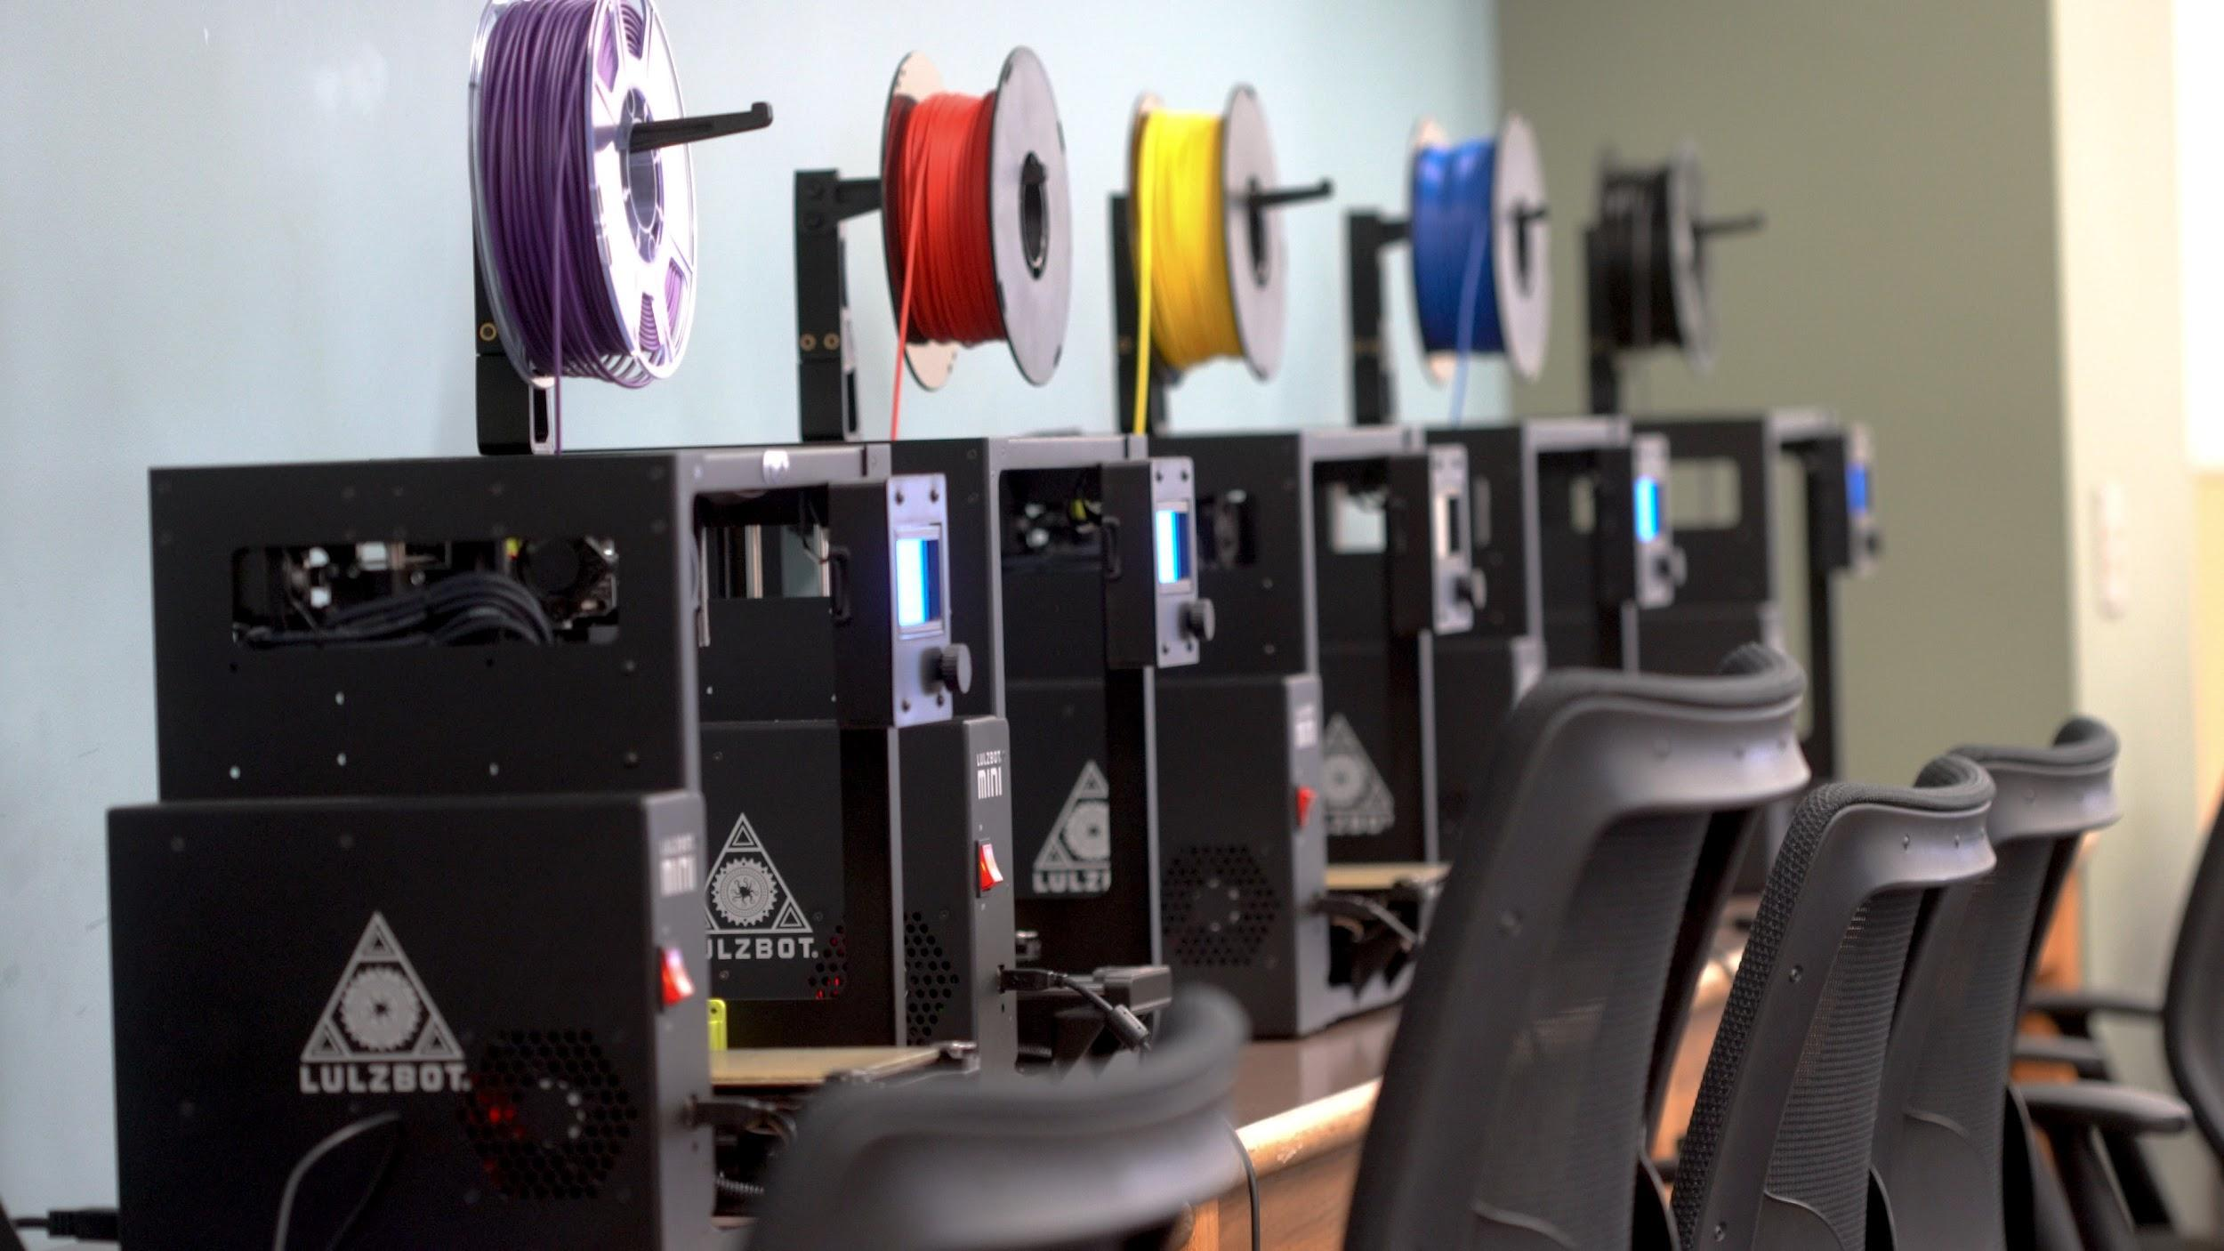
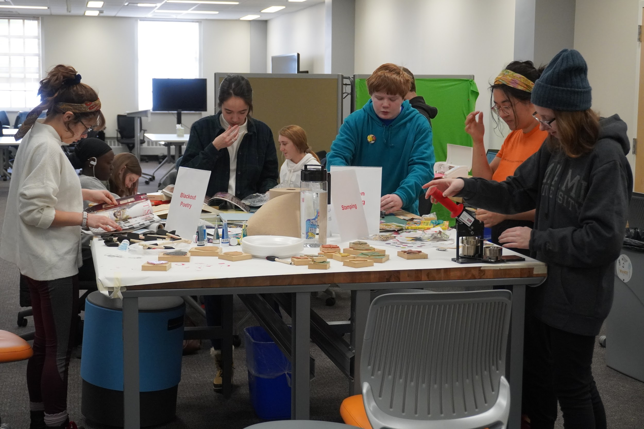
About the MUL Makerspace
Opened in August 2019
Equipment:
3D Printers
Carvey CNCs
Sewing/Embroidery Machines
Silhouette Cameos
Heat Press
Sublimation Printer
From the Makerspace’s opening in August 2019, to our COVID-related closure in mid-March, 2020, we saw 977 total walk-ins, and 312 unique registered users

Slide 4
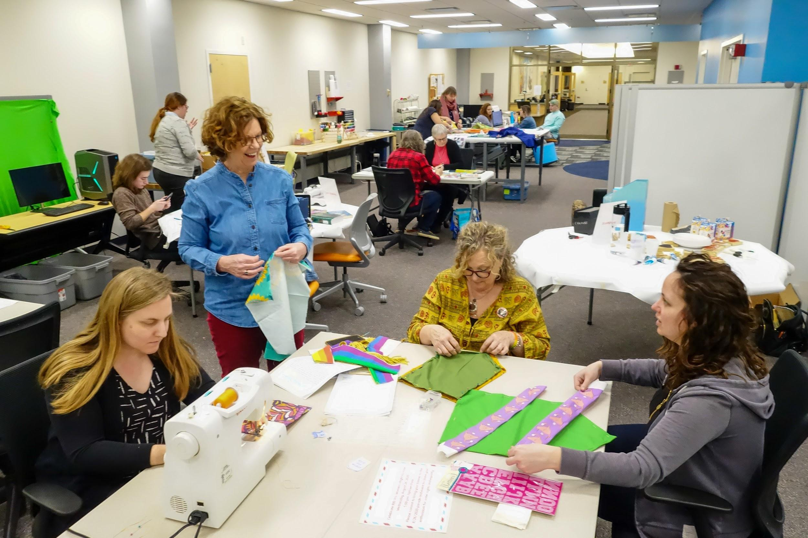
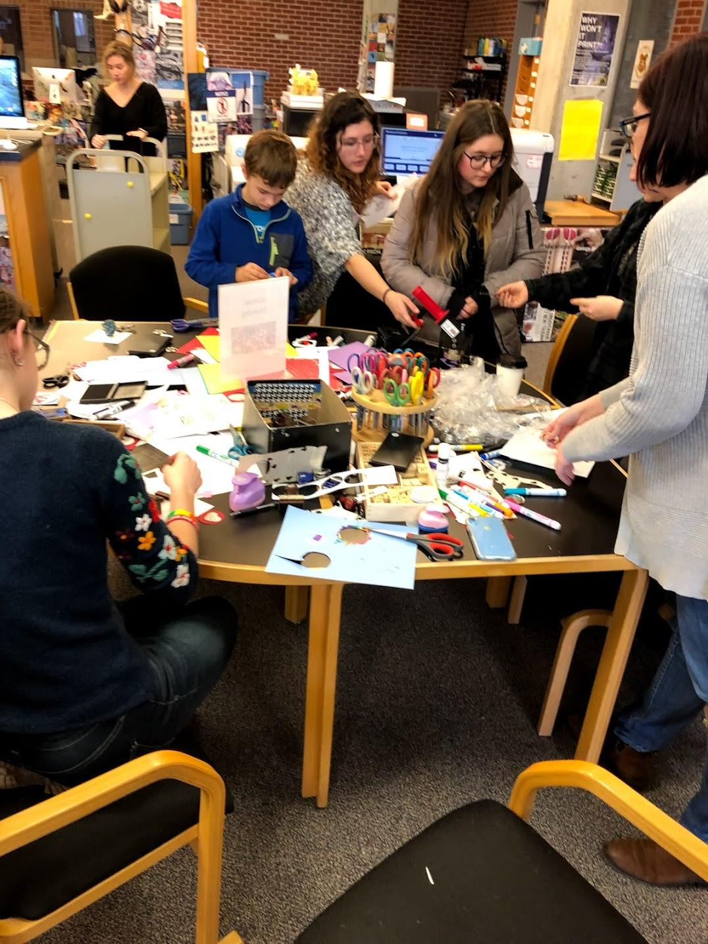
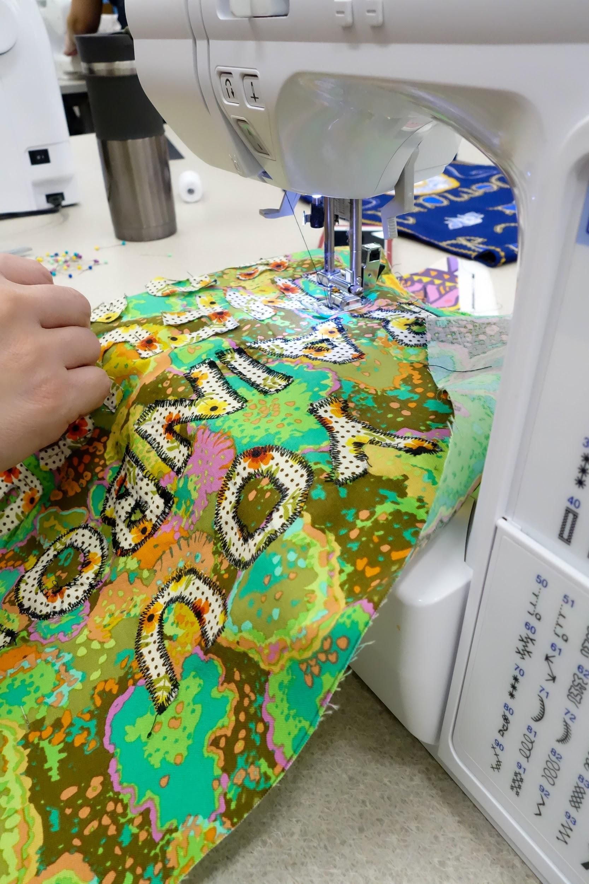
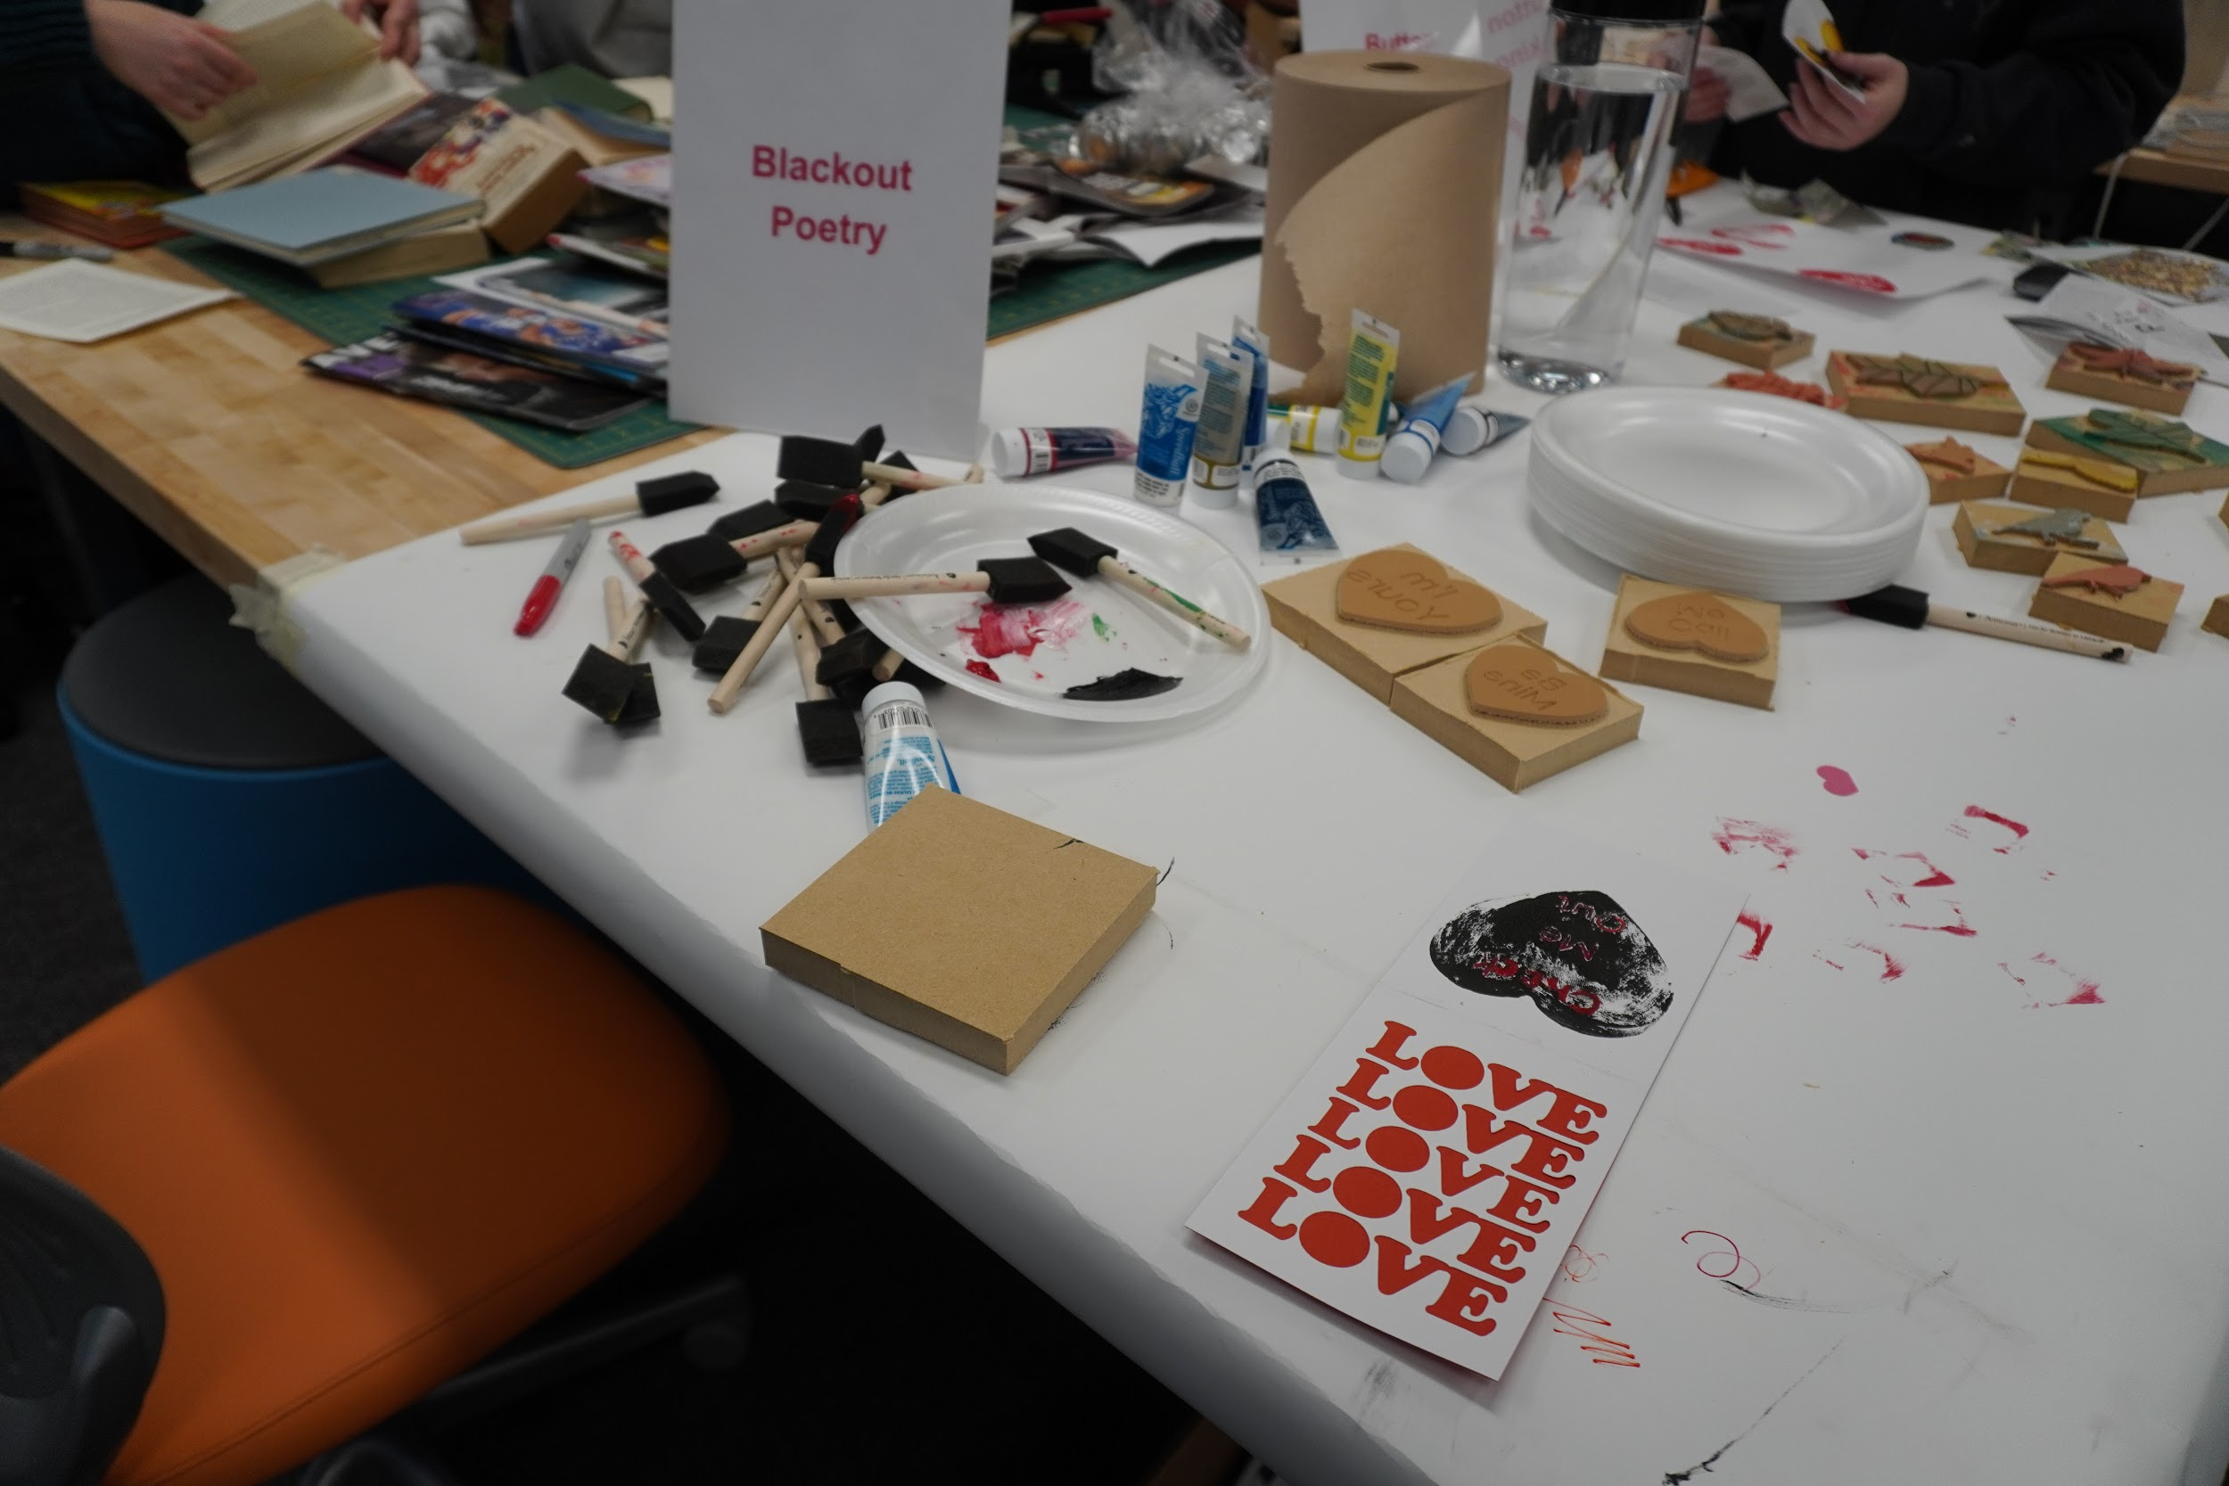
In-person Events
Total attendance for Fall 2019 Makerspace events was 561, and 115 for the first part of Spring 2020 semester before closing
I Heart Art
Creepy Crawly Crafts
Craft Your Heart Out
MakeHERspace

Slide 5
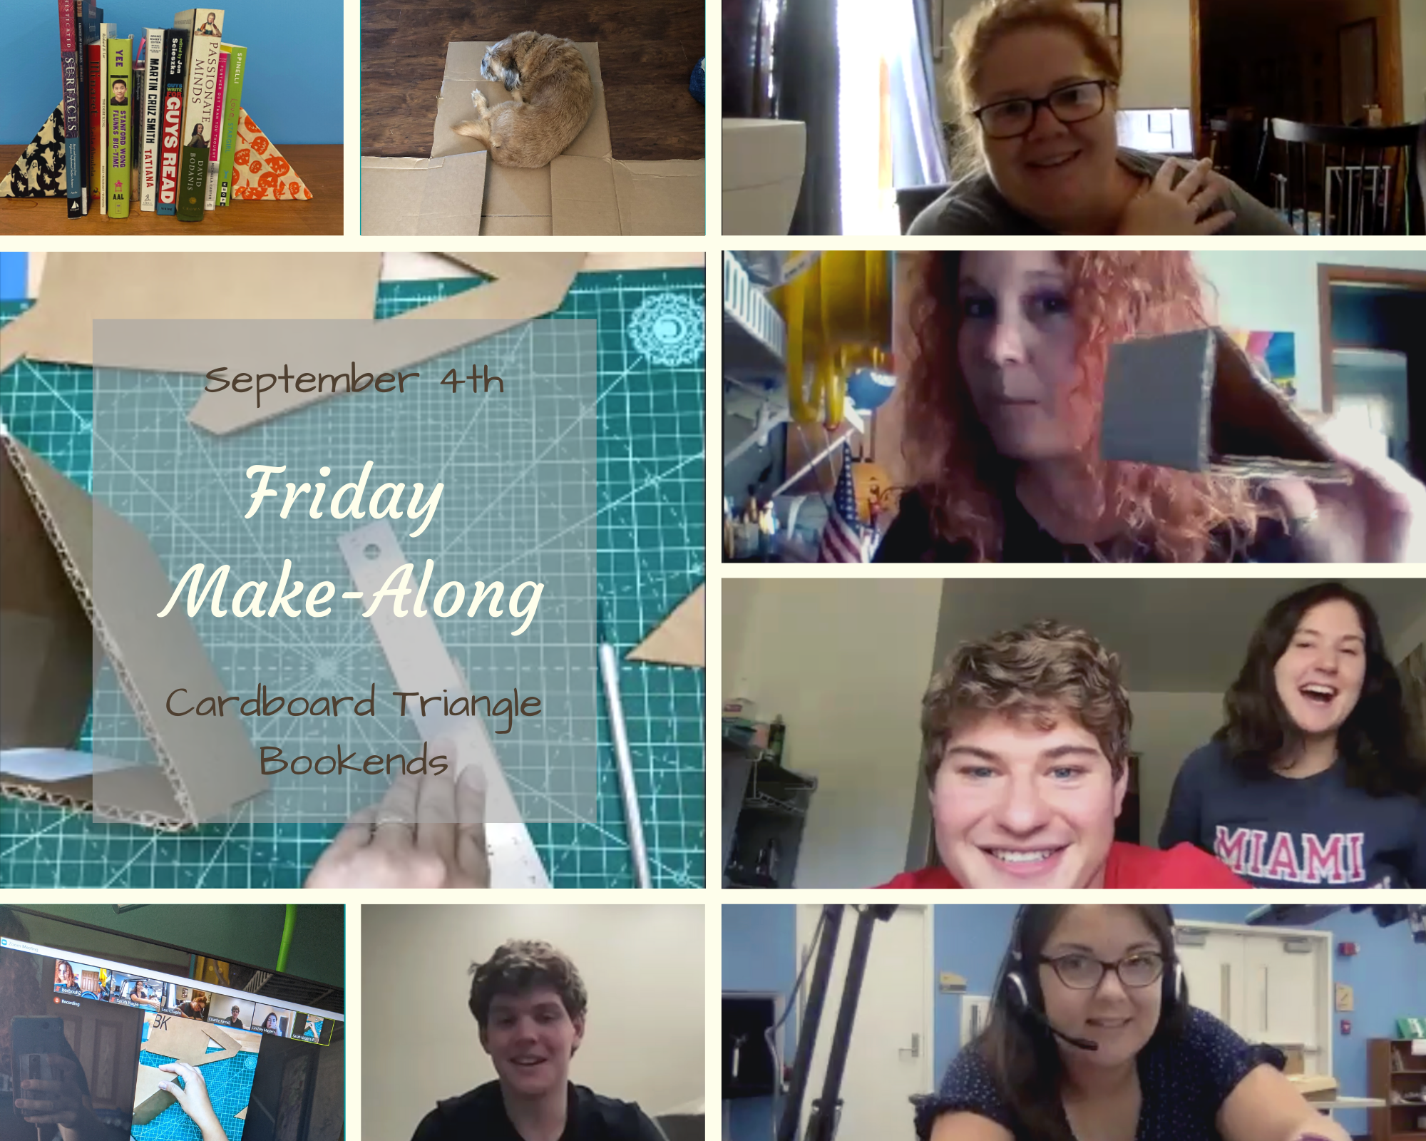
Friday Make-Alongs
Recreate community of in-person events
Very simple projects
Focus on student well-being, anti-stress

Slide 6
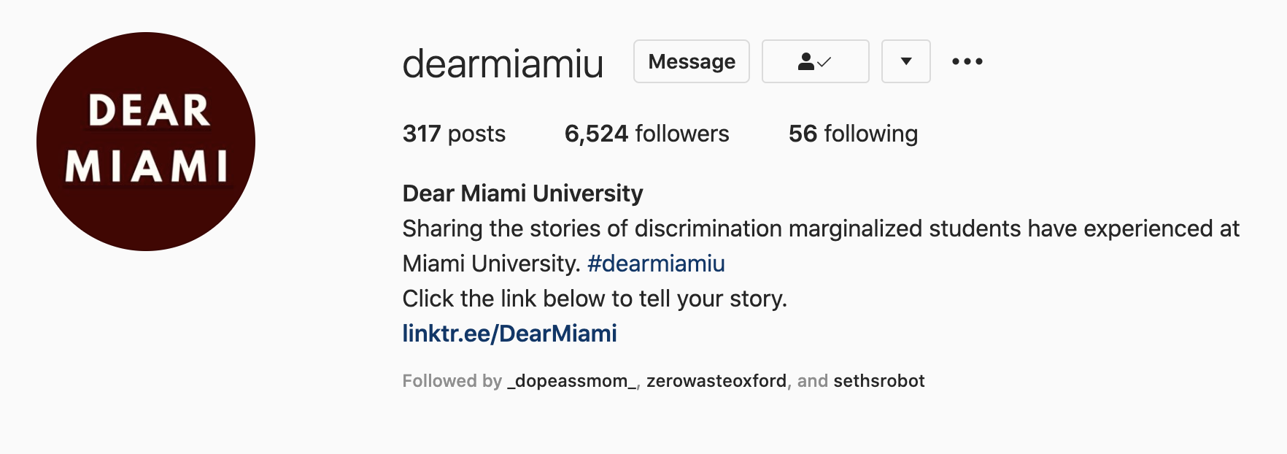
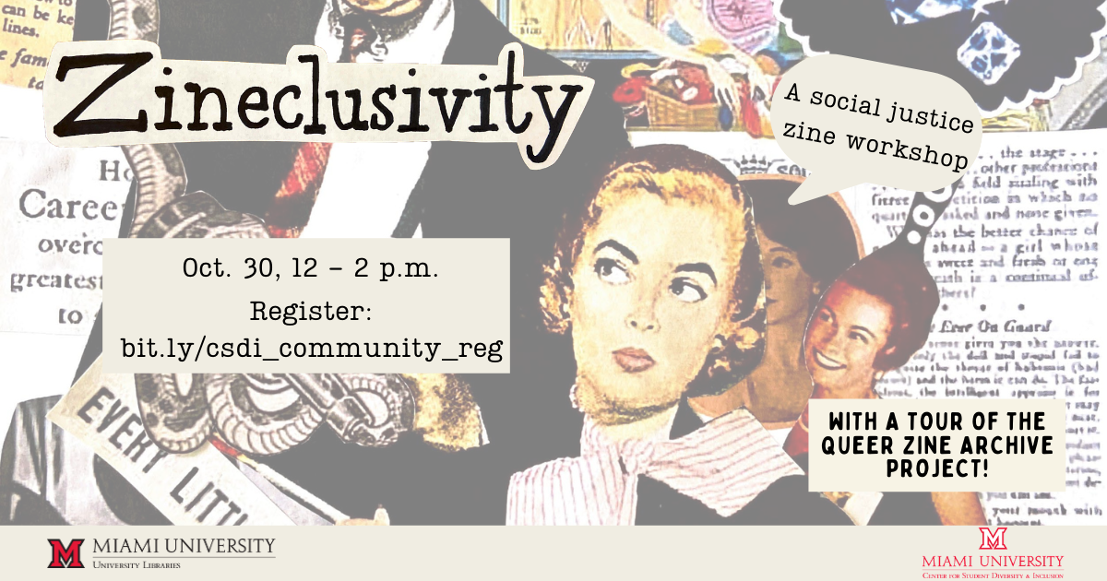
Zineclusivity
Stories of discrimination, micro-agreessions, sexual harassment
Students expressing frustration
Give students a voice and outlet
“How can we make Miami more inclusive”
Tour of Queer Zine Archive Project
Talk on using zines for social justice

Slide 7
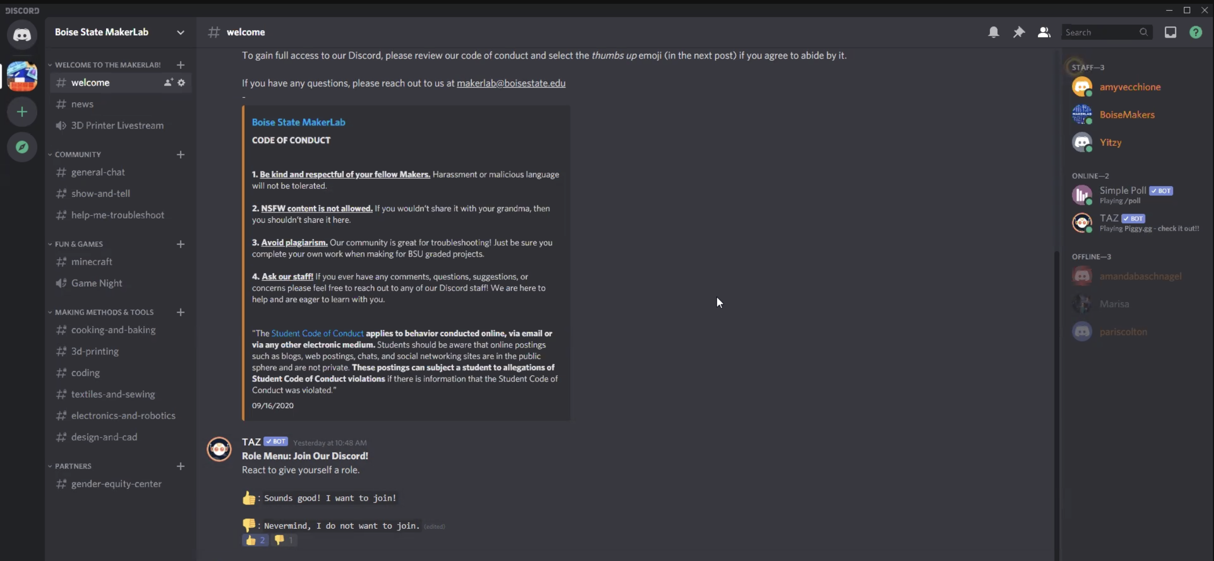
Discord
Screenshot from Boise State MakerLab Discord Server

Slide 8
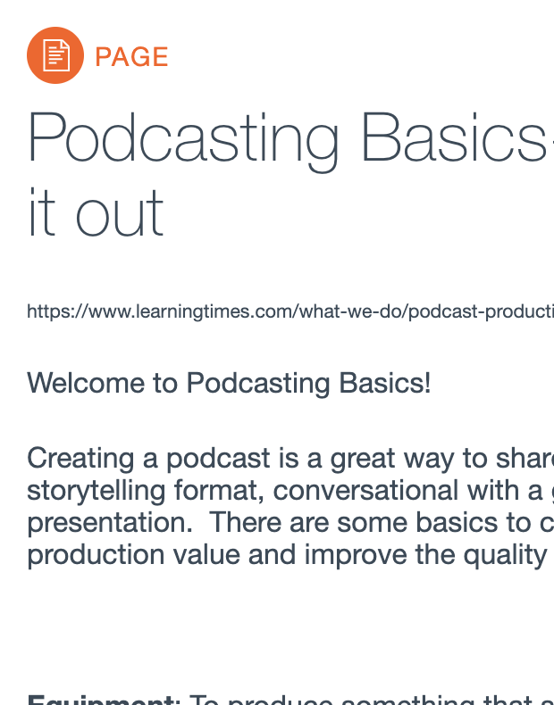
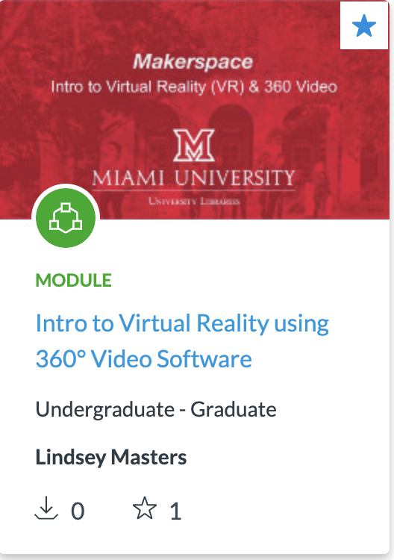
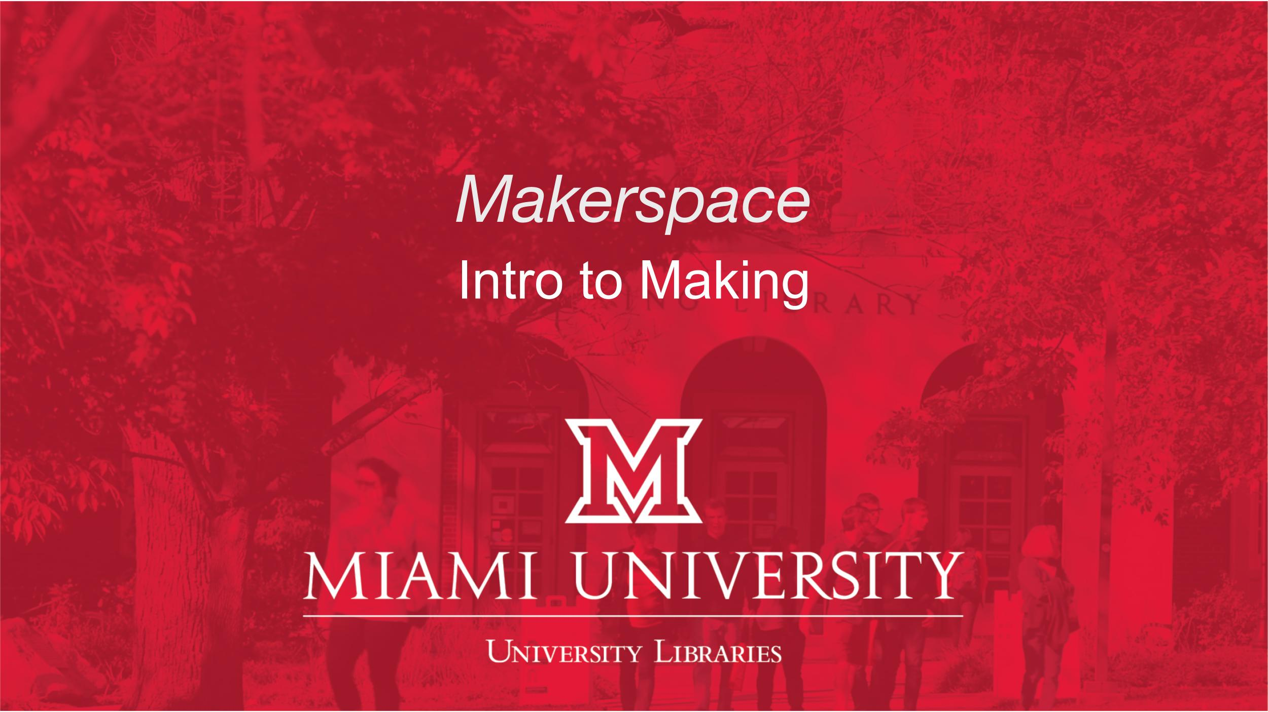
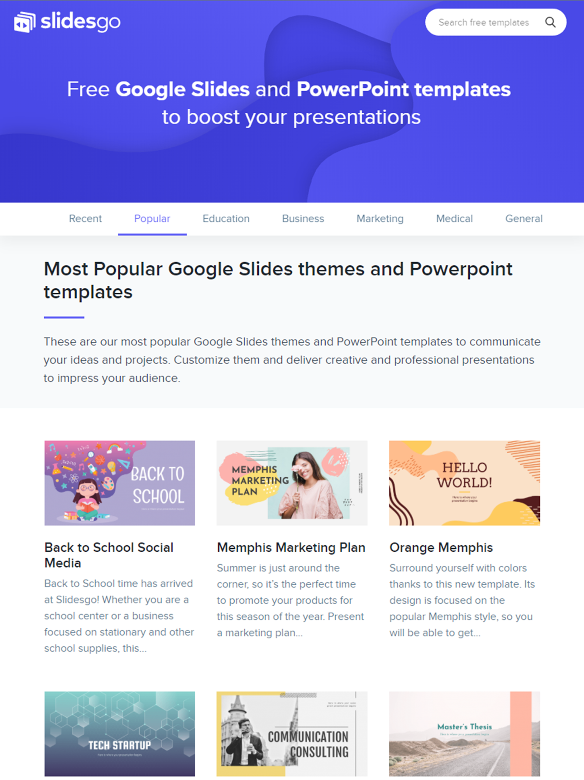
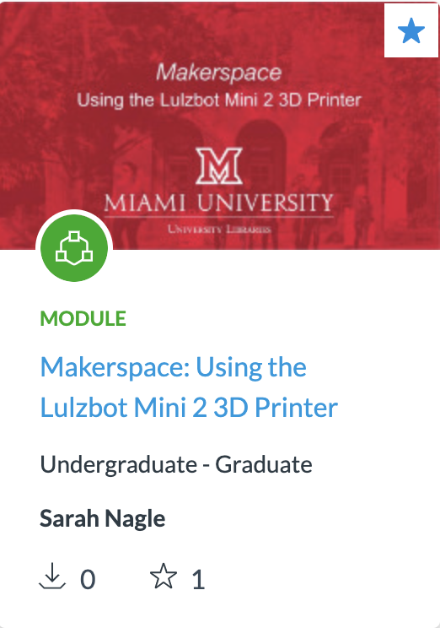
Canvas Modules

Slide 9
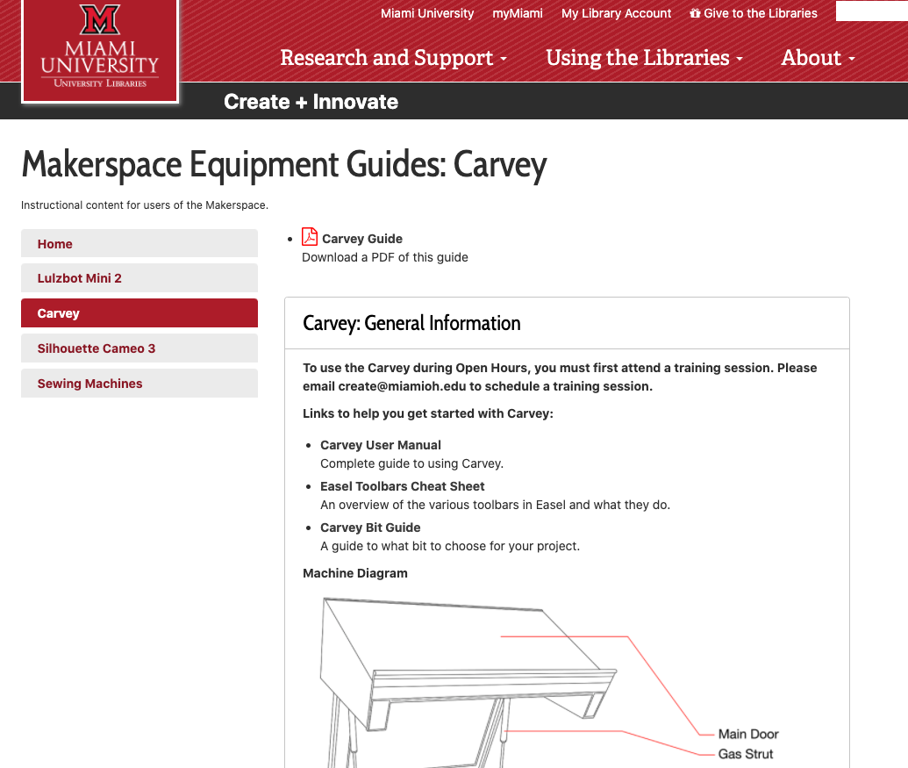
Libguides
Equipment specific
&
Spaces/Labs

Slide 10
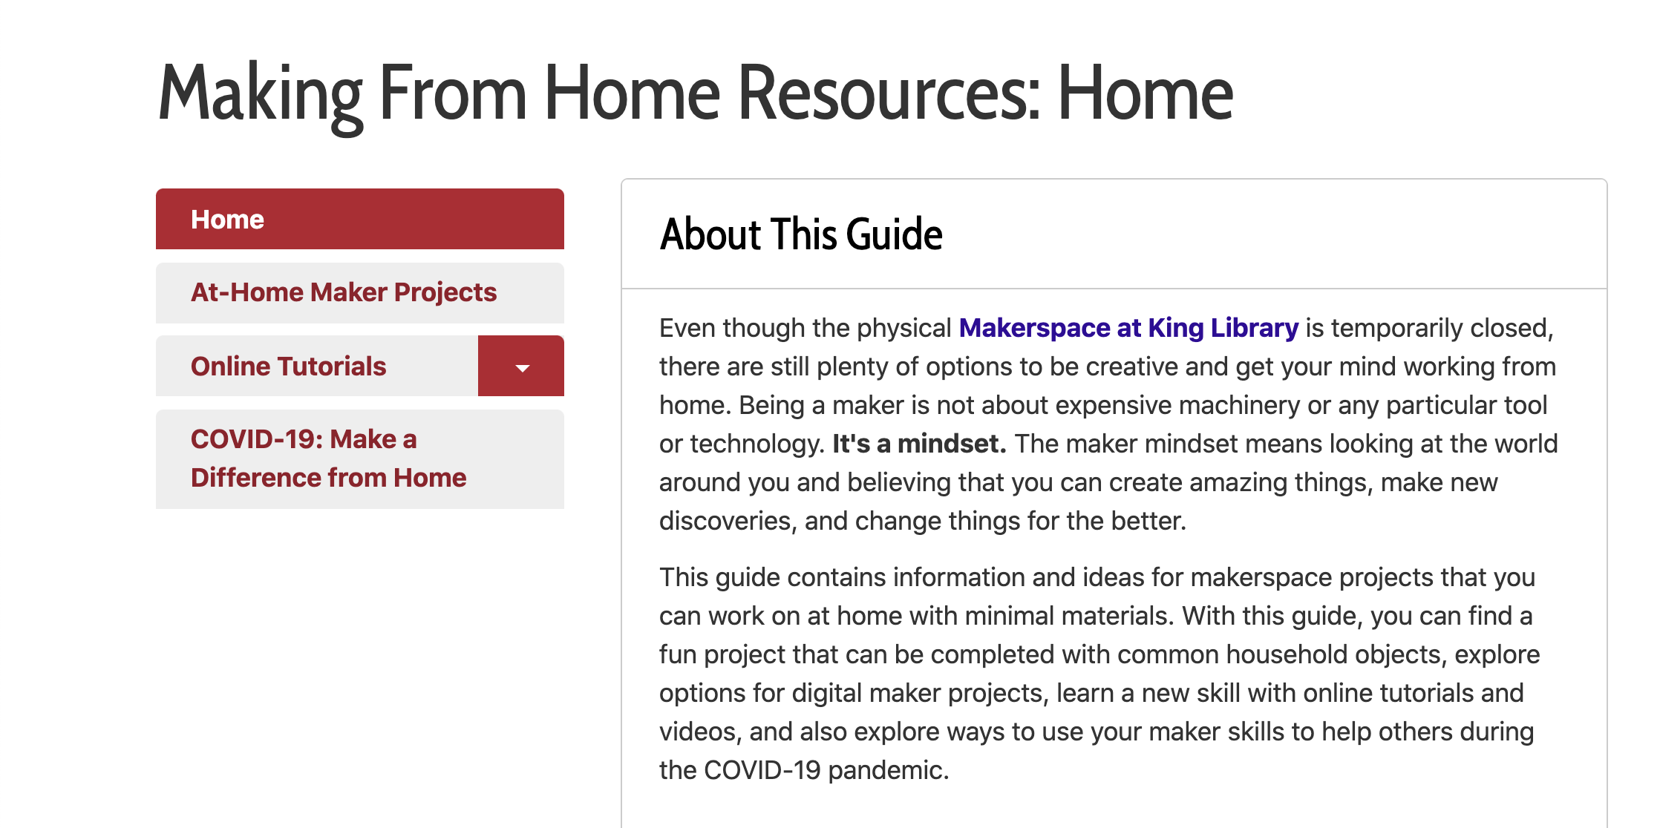
Libguides
Making From Home Guide

Slide 11
Chat Service

Slide 12
Kits: Making the connection
—attributed to Benjamin Franklin
“Tell me and I may forget, teach me and I may remember, involve me and I learn.”

Slide 13
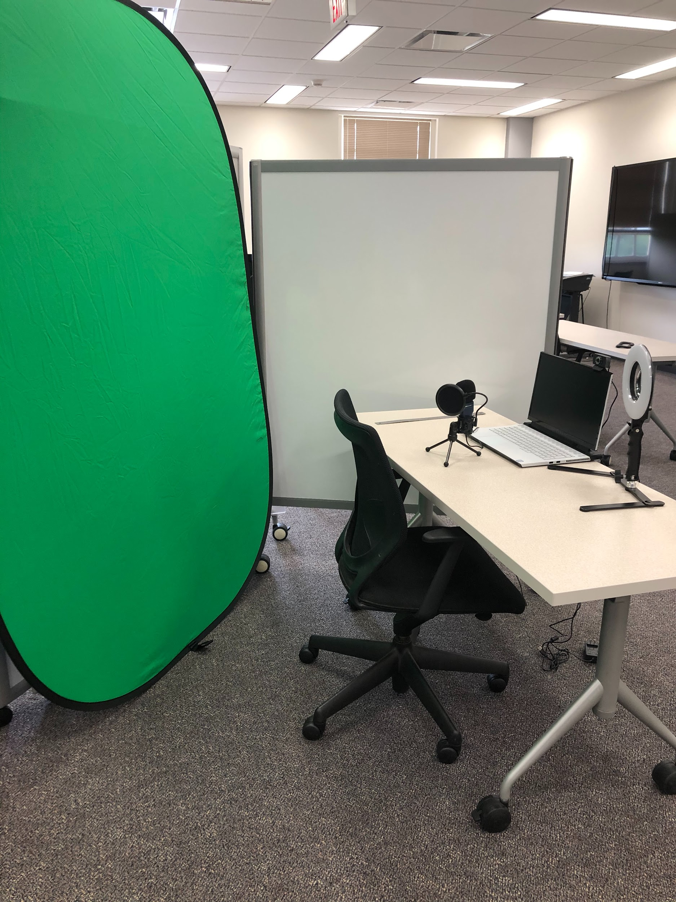
Kits Available for Check Out
AV Kits:
USB Mic w/ tripod stand and pop filter
Portable backdrop w/ stand white/black
Backdrop panel chroma key green/blue
HD Webcam
Desktop Ring Light

Slide 14
Future Kits in Development
Sewing Kits
Arduino Kits
Audio Kits
Robotics Kits

Slide 15

Augment Costs with Grants
Shows library leadership:
Ideas have value
You have dedication
Library doesn’t have to shoulder all costs

Slide 16
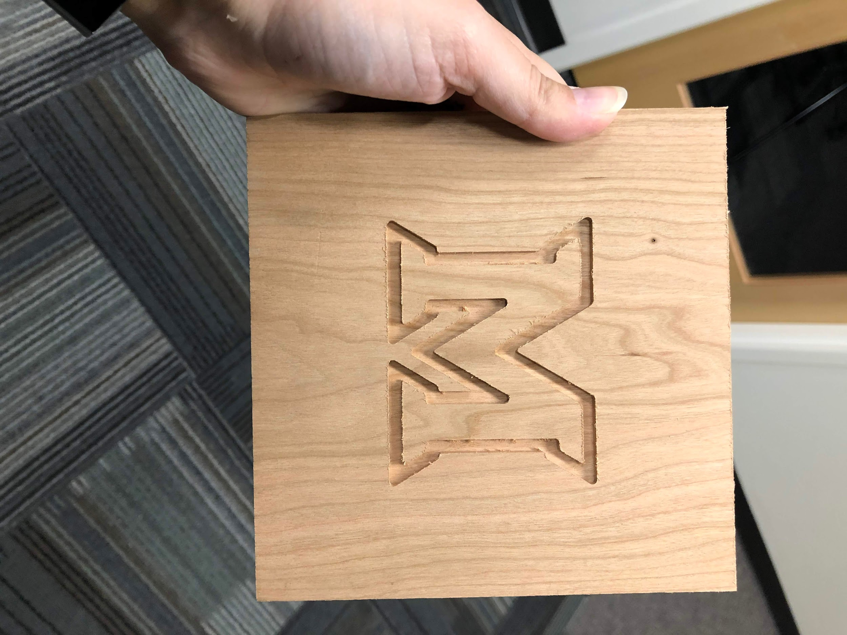

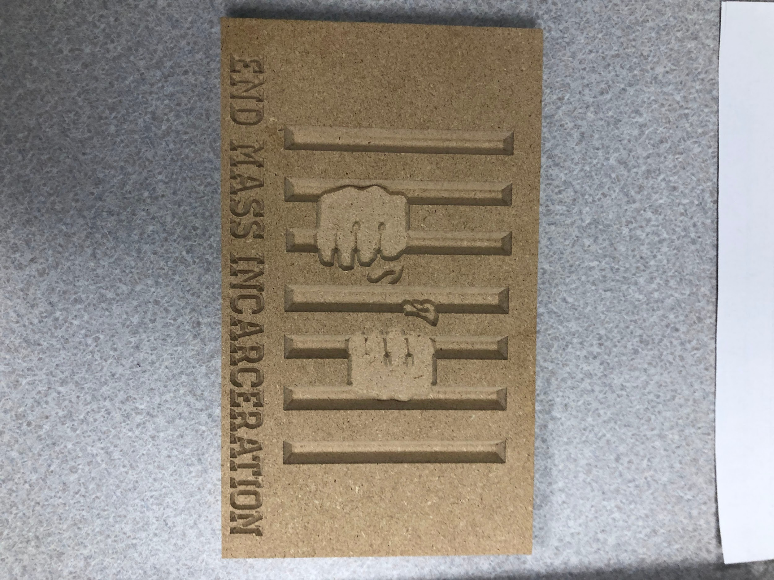
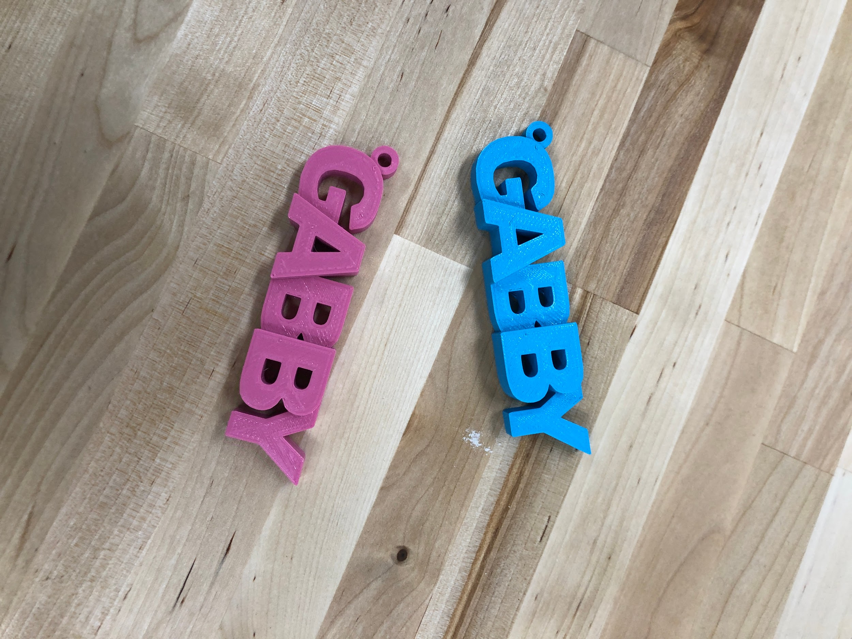
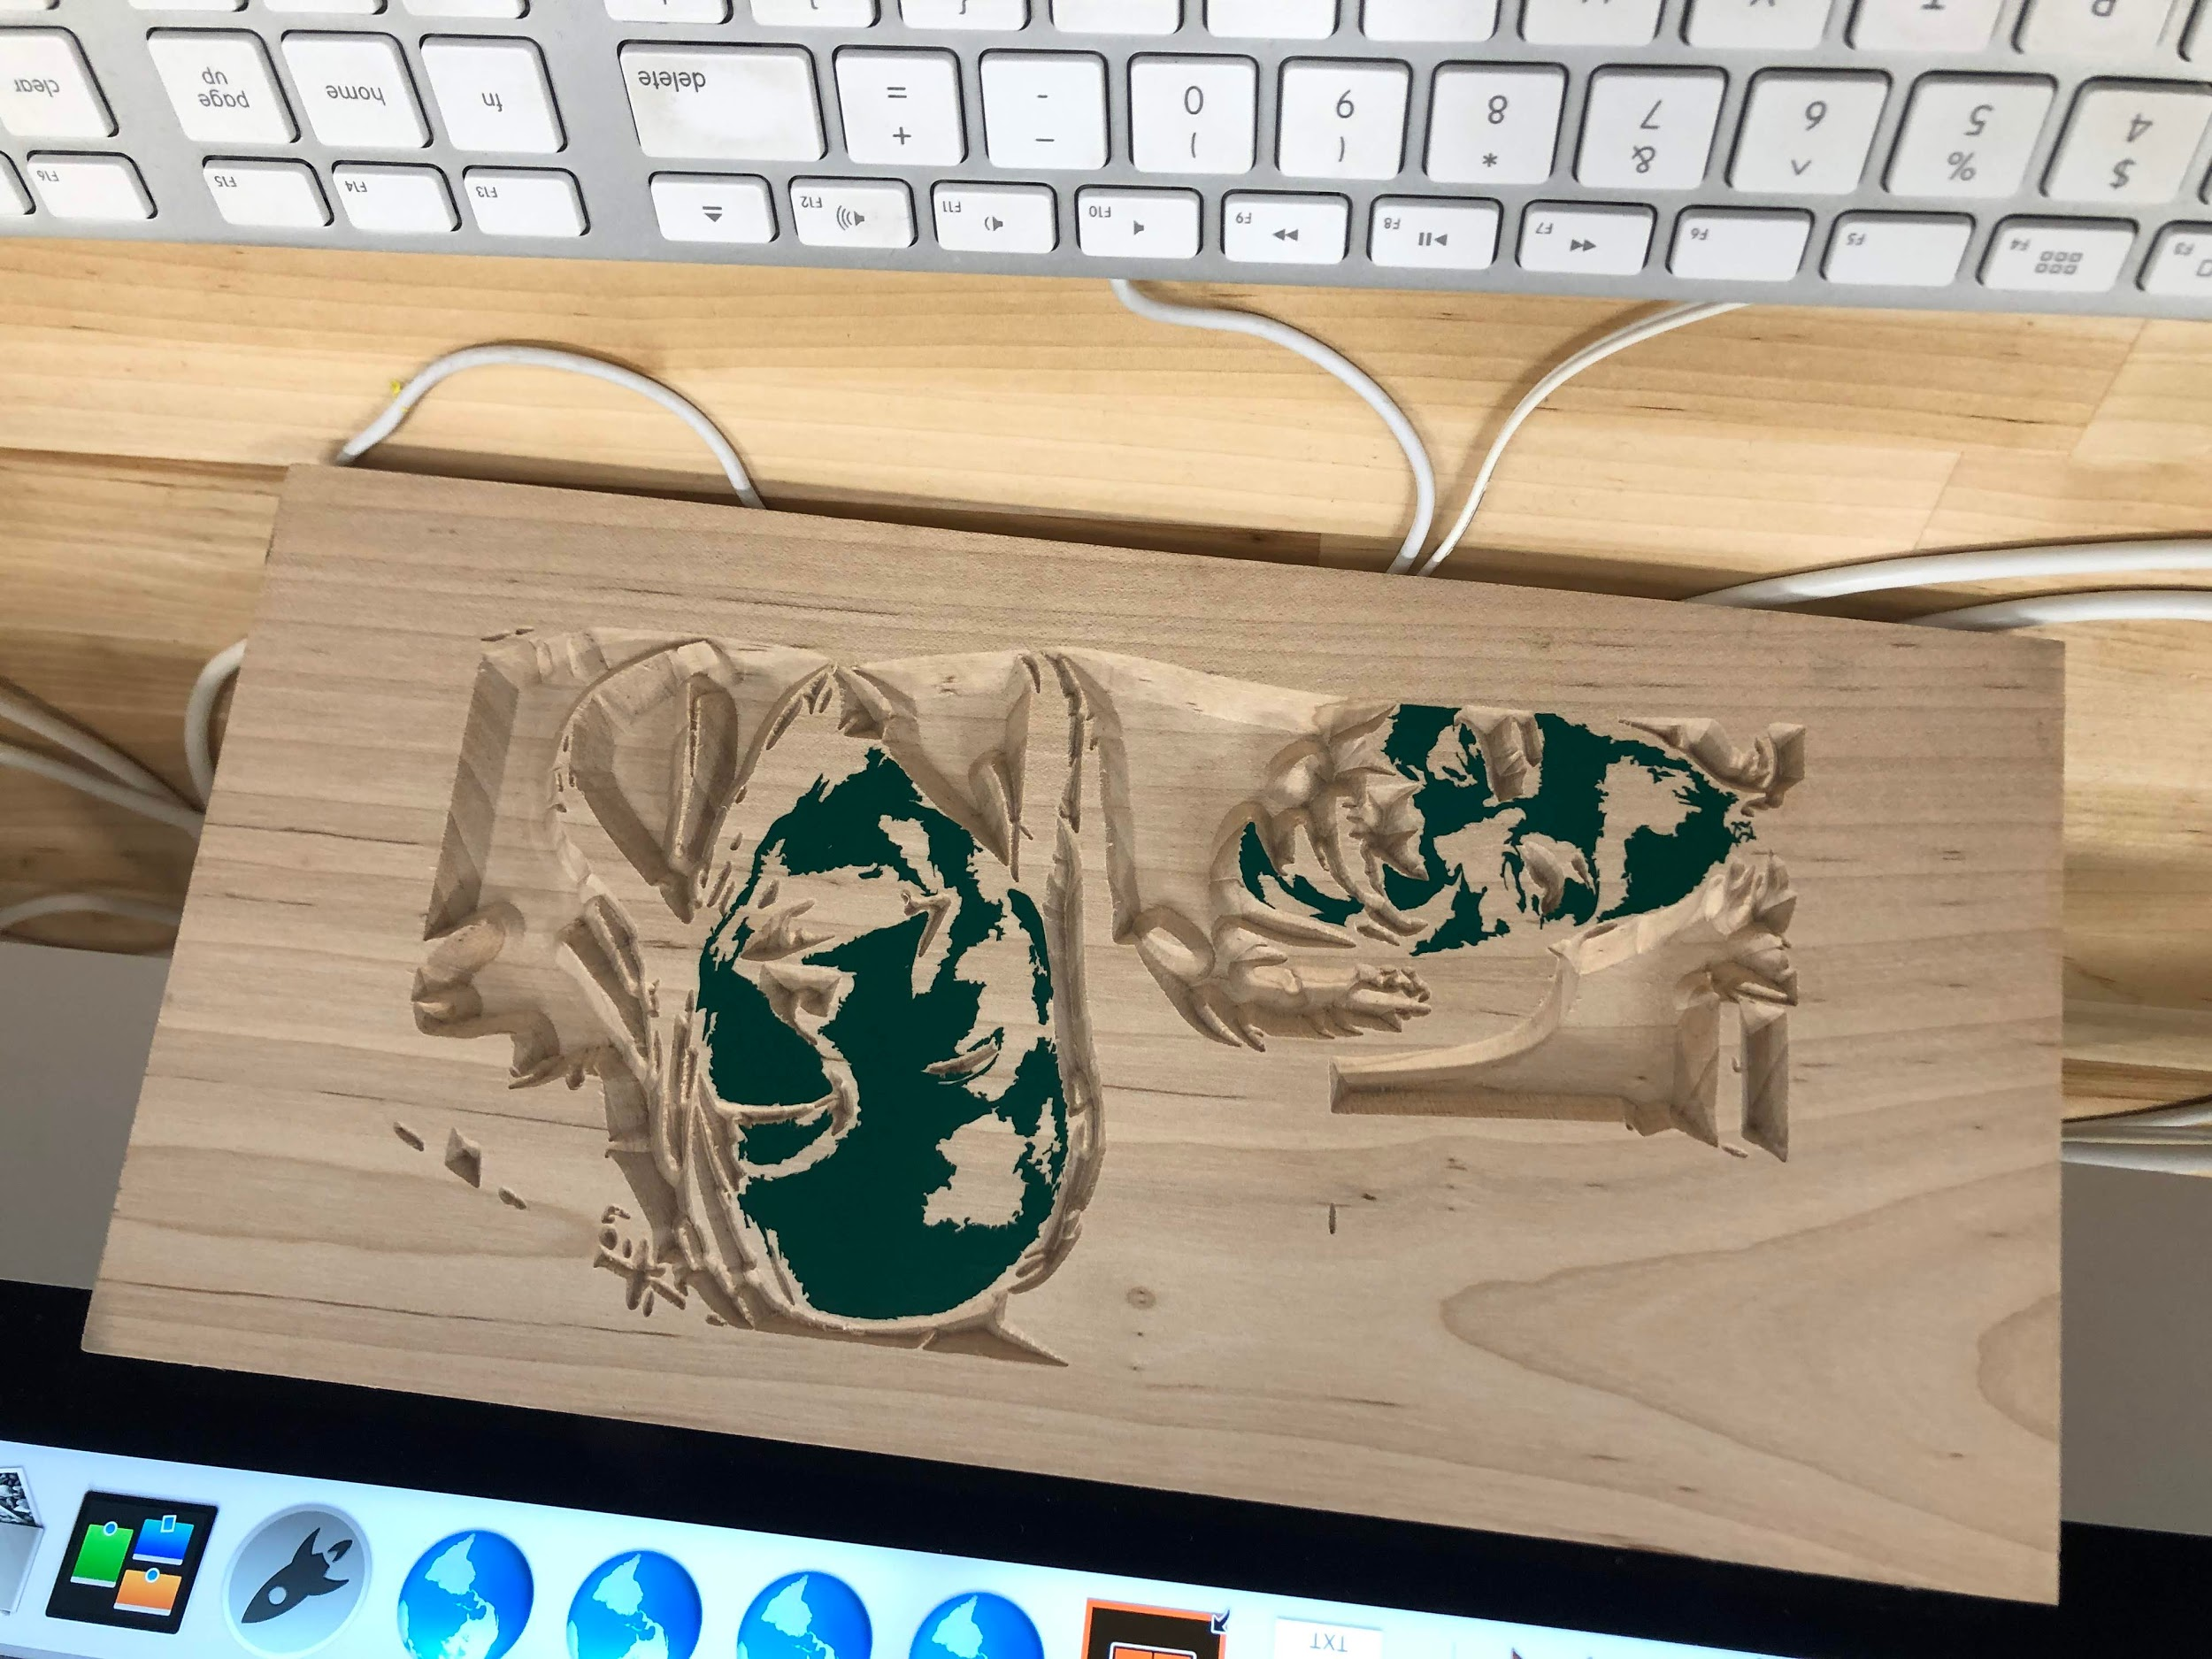
Working with Faculty
Increase traffic & usage
Shows value to admin
Enrich learning at your institution

Slide 17
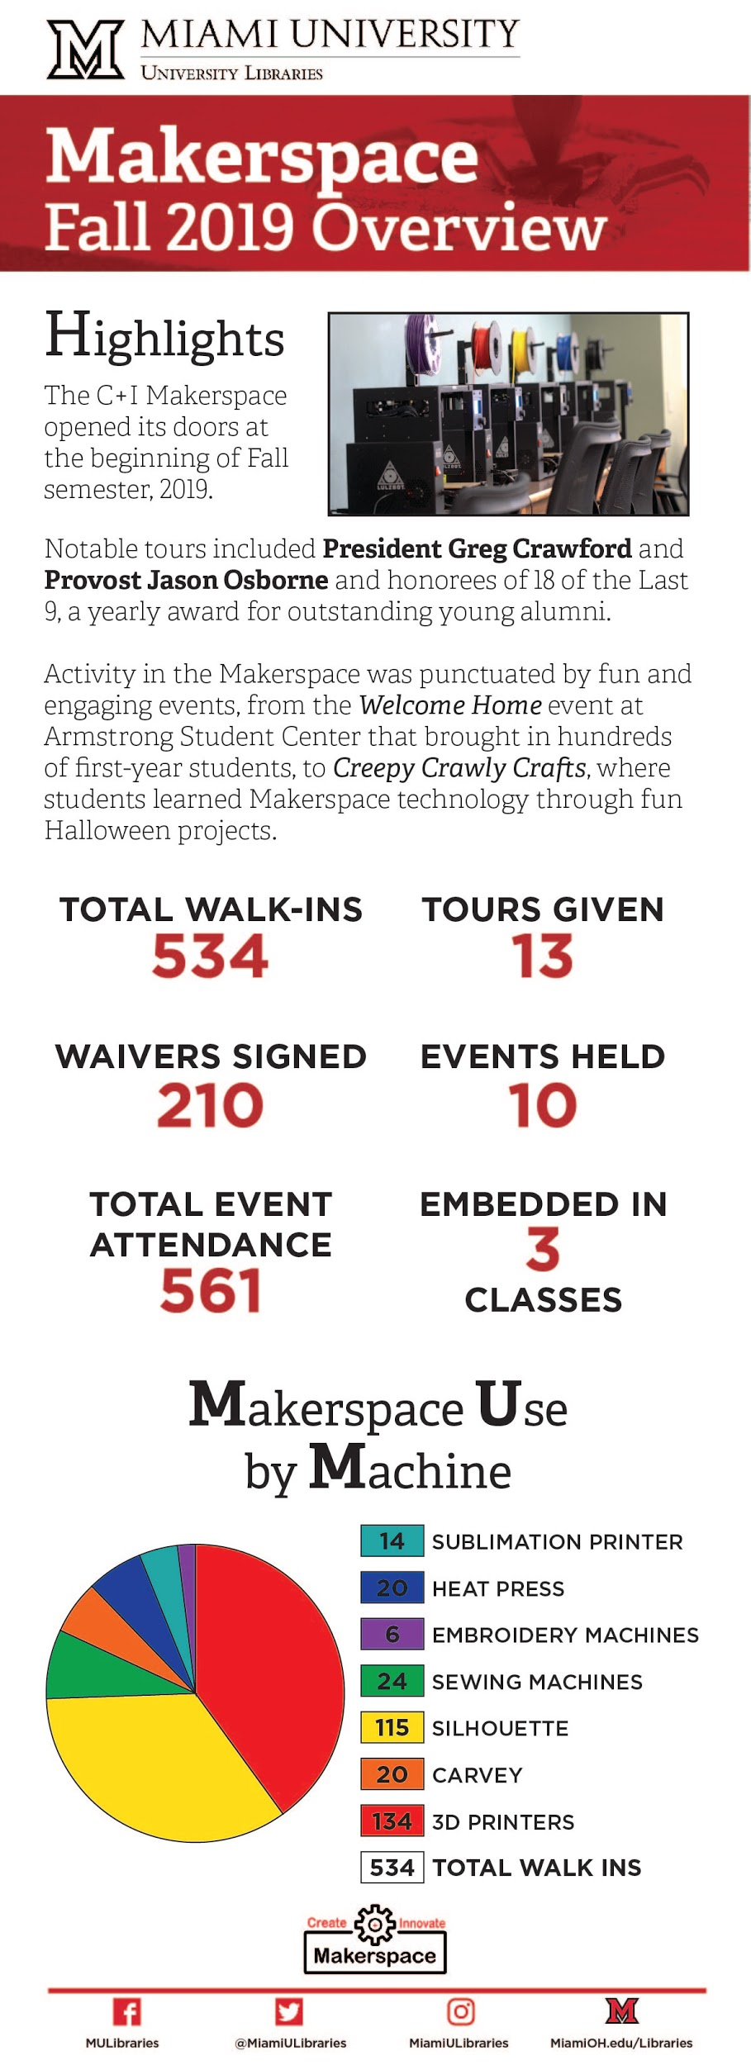
Infographics are Your Friend!

Slide 18
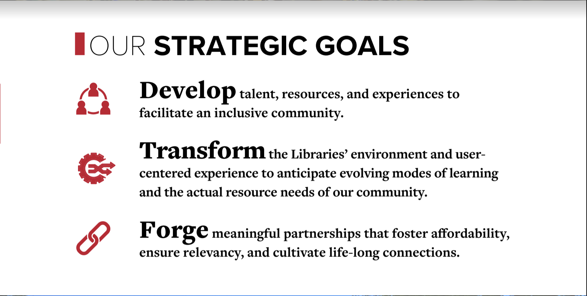
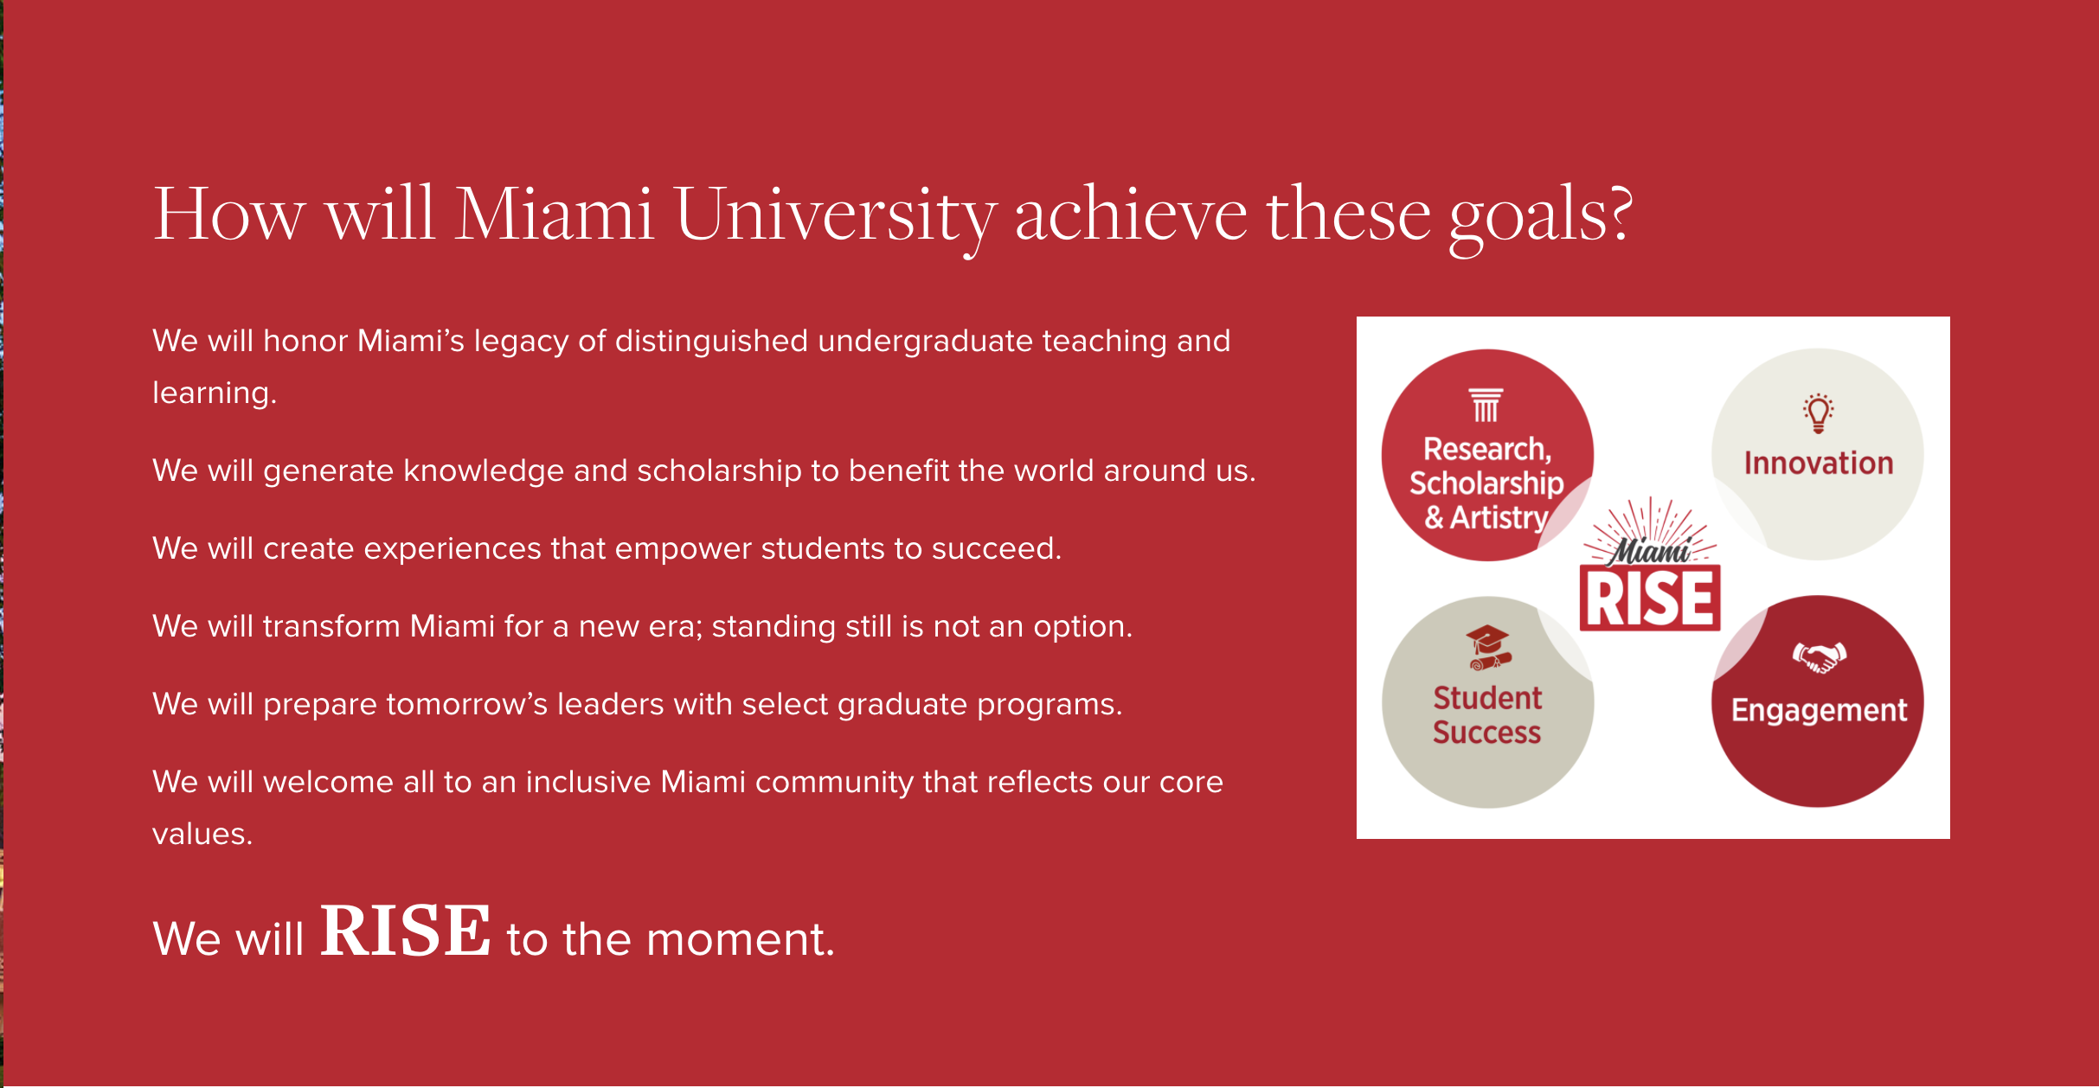
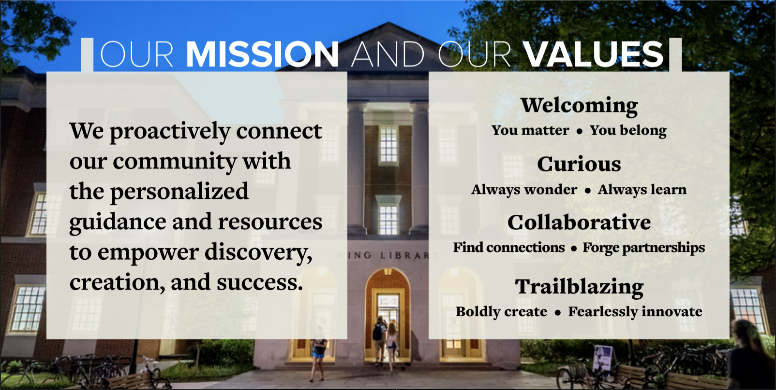
Connecting to MUL and Miami Strategic Plans/Mission/Values

Slide 19

Questions?
Contact Us!
Lori Chapin pheanila@miamioh.edu
Sarah Nagle pricesb@miamioh.edu @SarahNagle10

